Slide 1
Meet the Coaches
School Year 2022 - 2023

Slide 2
Agenda
Welcome
Haltom Football Boosters – Debbie Villavicencio
Haltom City Pee Wee Association
ASPIRE
7th Grade Arrival
Locker Room
Footwear
Band Sectionals/Tutorials
Hygiene
Playing Time
Pick – Up Time

Slide 3
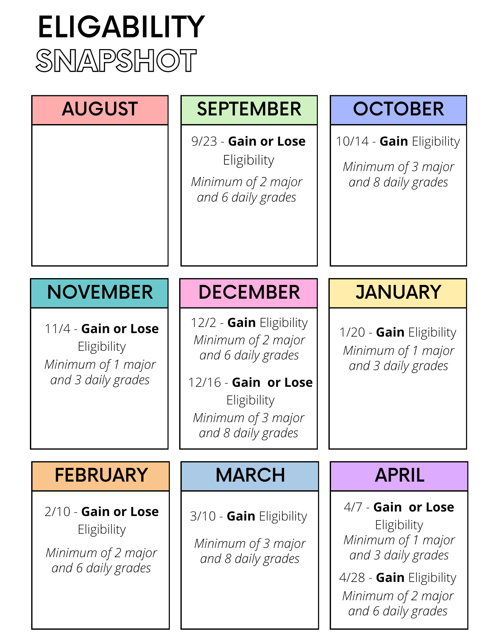
4. Grade Eligibility

Slide 4
5. 7th Grade Arrival
Arrival 6:30 – 6:45 a.m.
B-3 opens at 6:45 a.m.
Late at 7:15 a.m.
Please do not drive up the drive way!
If it is raining we will still practice!

Slide 5
6. Locker Room
Lock you stuff in your locker
We label everything that we hand out to the student (except practice jersey)
They have a big locker and everything can and will fit in their locker

Slide 6
7. Footwear
No Slides in the weightroom
No Crocs in the weightroom
A pair of athletic shoes is recommended for weightlifting and when we are forced inside due to weather

Slide 7
8. Band Sectionals/Tutorials
Band/Choir/Theatre Sectionals are priority
Tutorials Times are available for 7th grade
  During Breakfast (After practice)
  During Lunch
  After School
  ASPIRE
Tutorials Times are available for 8th grade
  During Breakfast
  During Lunch
  ASPIRE

Slide 8
9. Hygiene
No AXE Body Spray or any other brand of body spray
You will have time to shower each day!
If you do not want to shower you can bring shower wipes!
Deodorant!!

Slide 9
10. Playing Time
If you are tardy/late to practice or class – effects playing time
If you miss practice – effects playing time
If you are a disruption in class – effects playing time
If you are a disruption in the hallway – effects playing time
If you are disrespectful – effects playing time

Slide 10
11. Pick Up Time
We try to be as consistent as possible when we end practice daily… thank you for being here on time these first few weeks!
We will communicate with the student/athletes how far we are from school on game days… Please be here to pick up promptly after a game!

Slide 11
12. Key Dates
8th grade only – 9/5 Labor Day Monday
  9 a.m. – 11 a.m.
  Jerseys will be given out – Take advantage and come take pictures
Picture Day September 12
7th Grade Schedule – 7
  Monday – Friday – Is consistent all season!!
8th Grade Schedule
  Monday – 7th grade game – Period Only
  Tuesday – Game Day
  Wednesday – 5:00 p.m – Depends if 7th grade game day
  Thurday – 5:00 p.m.
  Friday – 4:45 – 5:00 p.m.

Slide 12
13. Paperwork
Rank One
  All Items must be completed
  Medical History
  COVID 19
  Emergency Release
  UIL Forms Signature Page

Slide 13
Contact Information
Twitter: @CoachGarcia
  To share pictures of games
Remind
  Text: 81010
  Message: @nomsath22

